Slide 1
DS Lab
Lecture #8, Overfitting & metrics

Slide 2
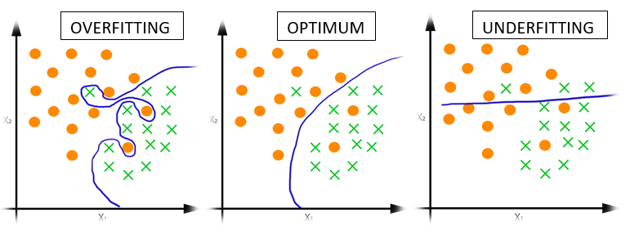
Quality of the learning

Slide 3
OVERFITTING

Slide 4
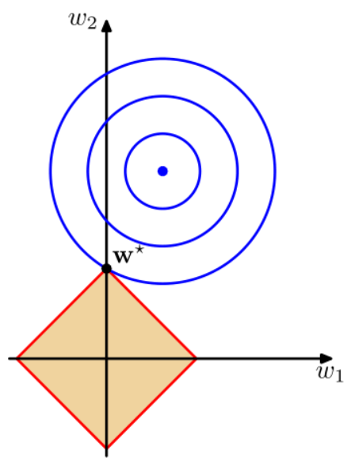

Regularization. L1
Lasso regularization
The coefficient of the parameters can be driven to zero as well during the regularization process. Hence this technique can be used for feature selection and generating more parsimonious model.

Slide 5
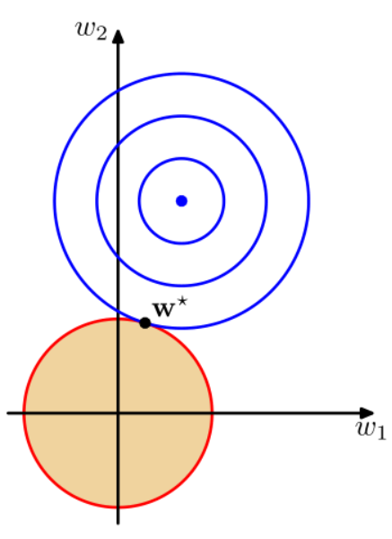

Regularization. L2.
Ridge regularization
Coefficient of parameters can approach to zero but never become zero.

Slide 6
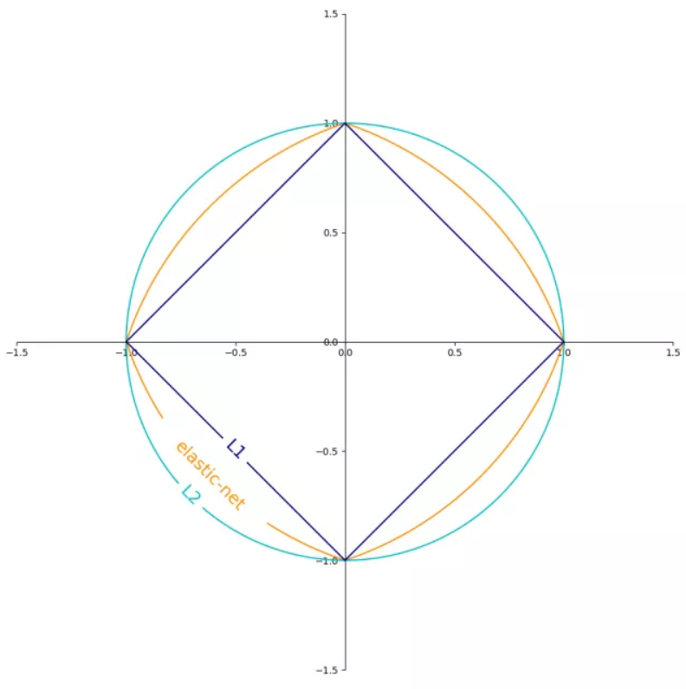

Regularization. Elastic Net

Slide 7
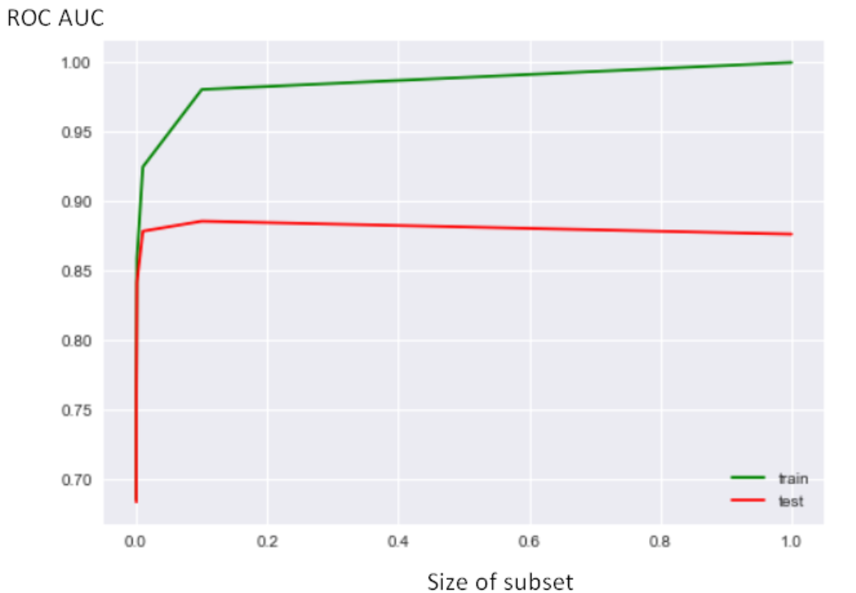
TRAIN-TEST
Proportions:
80/20
70/20/10
...
Blend it!
Stratify it
The same distribution

Slide 8
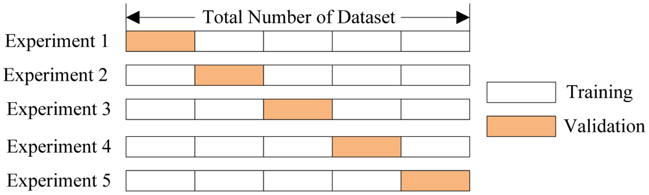
Cross-validation

Slide 9
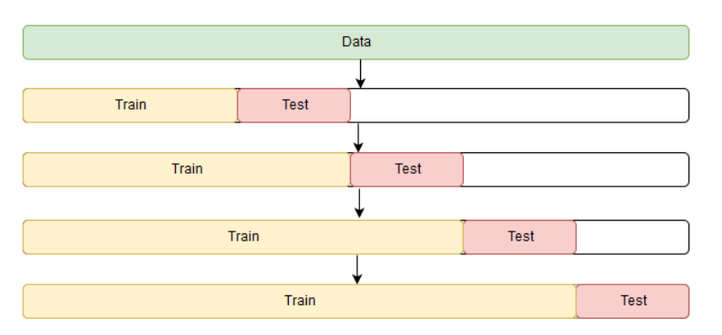
Time-series cross-validation

Slide 10
Split for choosing hyperparameters
Train + Validation + Holdout
Cross-validation + Holdout

Slide 11
UNDERFITTING

Slide 12
Underfitting
Give more samples (analyze learning curves)
Give more features (e.x. polynomial features)
Choose another model (more complex, analyzed by validation curves)

Slide 13
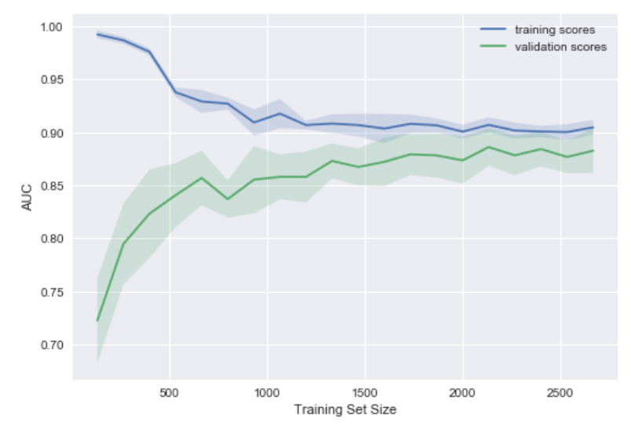
Learning curves and validation curves
Learning curves help to analyse the size ot training set
Validation curves help to choose parameters for models

Slide 14
How can we measure the quality of the model?

Slide 15
METRICS FOR CLASSIFICATION

Slide 16
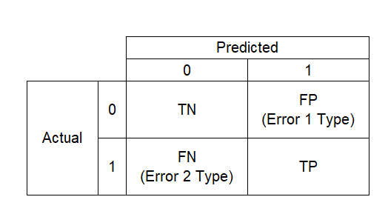
Confusion matrix
Goal: Churn detection
H0: There is no churn in the data.
H1: There is churn in the data.
Error 1 type rejects H0, error 2 type rejects H1.

Slide 17
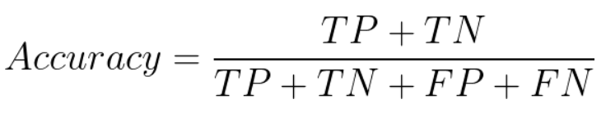
Accuracy
Pros:
Easy to use
Good if both classes are important
Cons:
Inappropriate for imbalanced classes

Slide 18
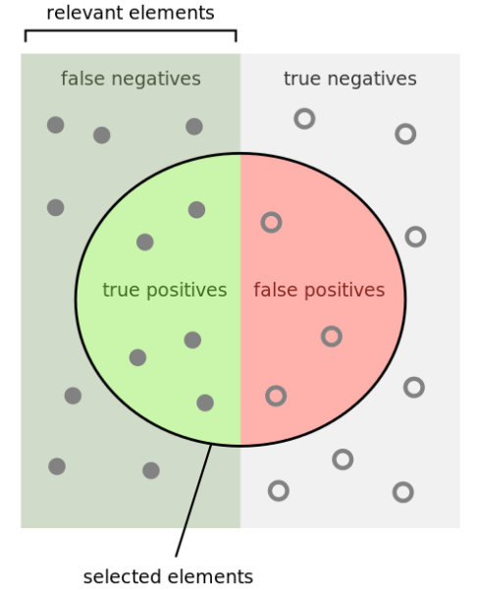
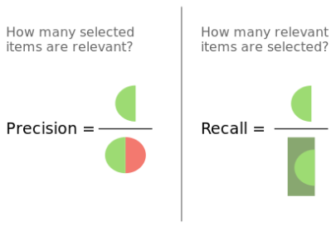
Recall & Precision

Slide 19
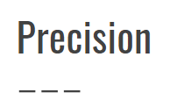
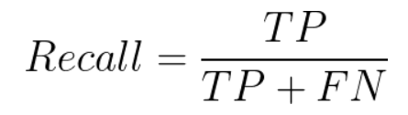
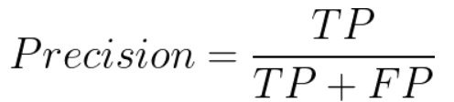
Recall
Sensible for Errors 2 Type
Sensible for Errors 1 Type
YOUR EXAMPLES :)

Slide 20
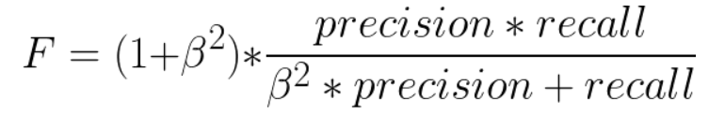
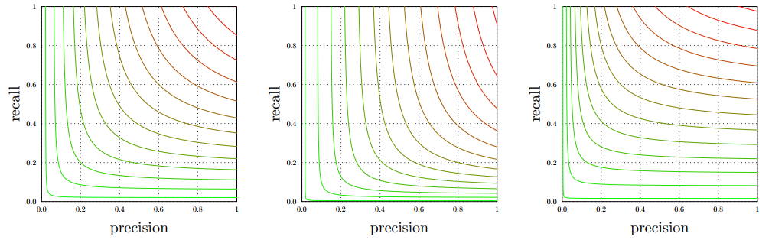
F-score

Slide 21
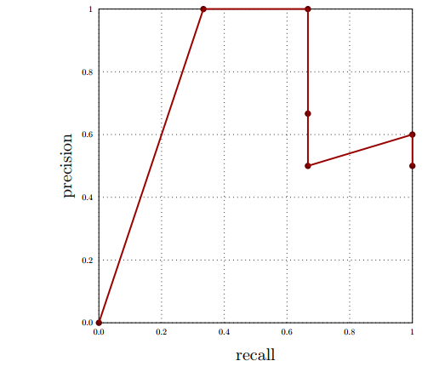

PR-AUC
Start - [0, 0]
End - [1, r], where r - part of samples 1-class
The best variant - [1, 1]

Slide 22
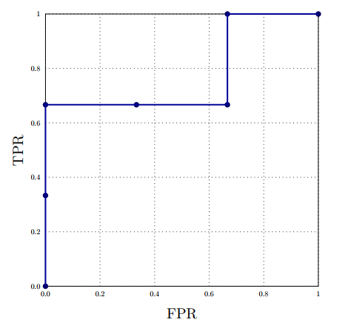
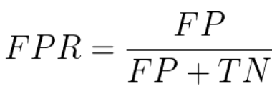
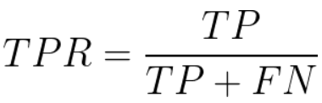
ROC-AUC
Start - [0, 0]
End - [1, 1]
The best variant - [0, 1]

Slide 23
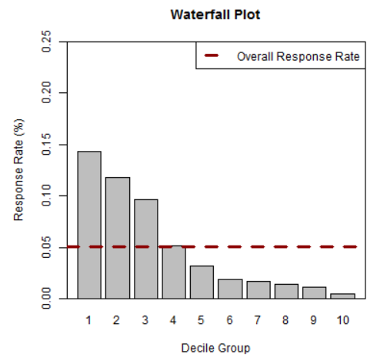
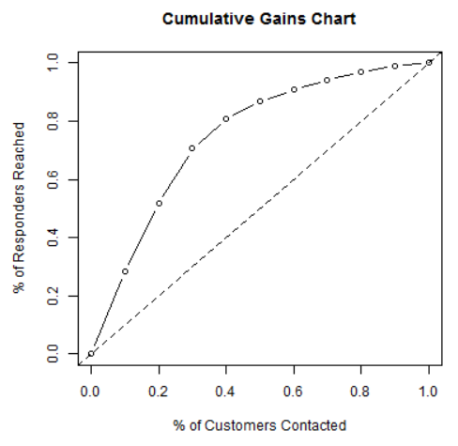
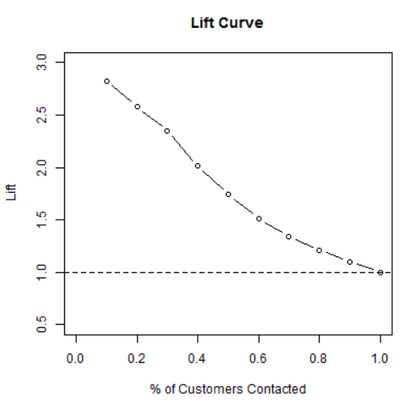
Business interpretations

Slide 24
METRICS FOR MULTICLASS CLASSIFICATION

Slide 25
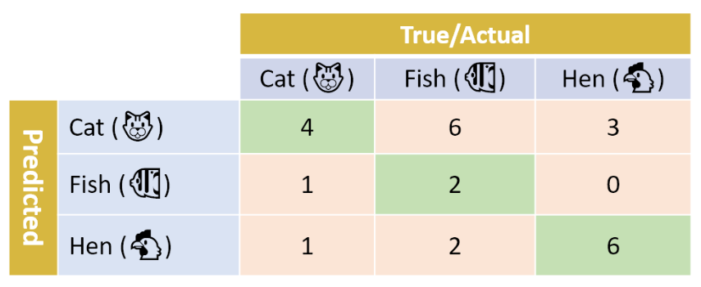
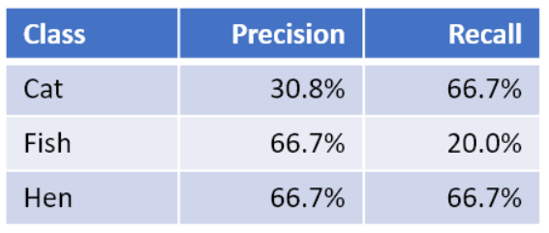
MACRO
Macro-precision =
(31% + 67% + 67%) / 3 = 54.7%
Macro-recall =
(67% + 20% + 67%) / 3 = 51.1%

Slide 26
WEIGHTED
Weighted-precision =
(6×30.8% + 10×66.7% + 9×66.7%)/25 = 58.1%
Weighted-recall =
(6×66.7% + 10×20.0% + 9×66.7%)/25 = 48.0%

Slide 27
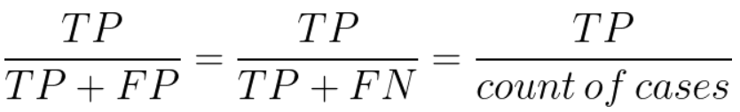
MICRO
micro-F1 = micro-precision = micro-recall = accuracy

Slide 28
METRICS FOR REGRESSION

Slide 29
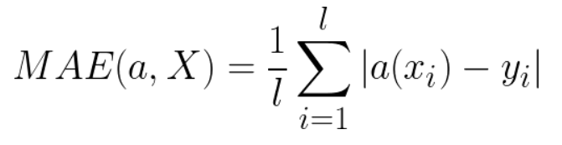
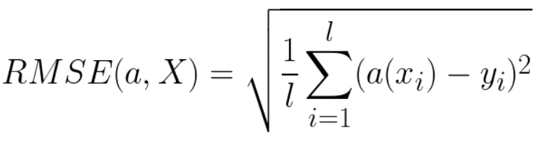
MAE, RMSE
Which is more robust?

Slide 30
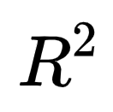
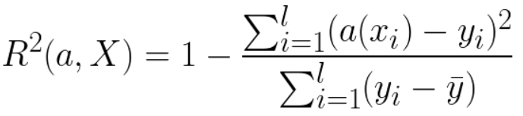
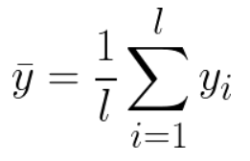
1 means the best model
0 means predictions like “constant”

Slide 31
METRICS FOR CLUSTERIZATION

Slide 32
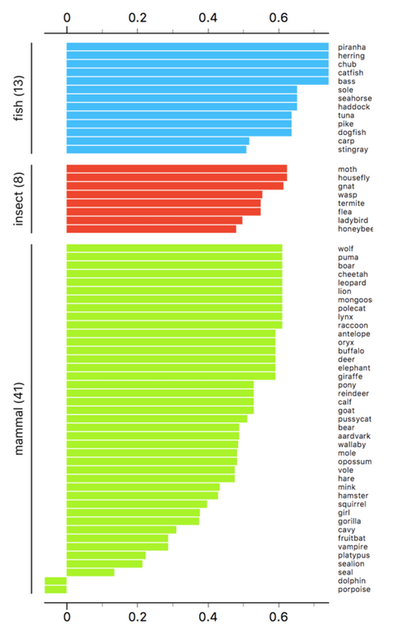
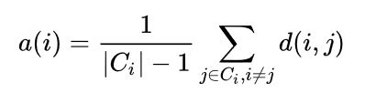

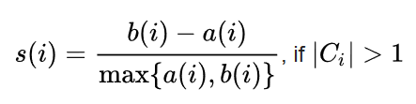
Silhouette

Slide 33
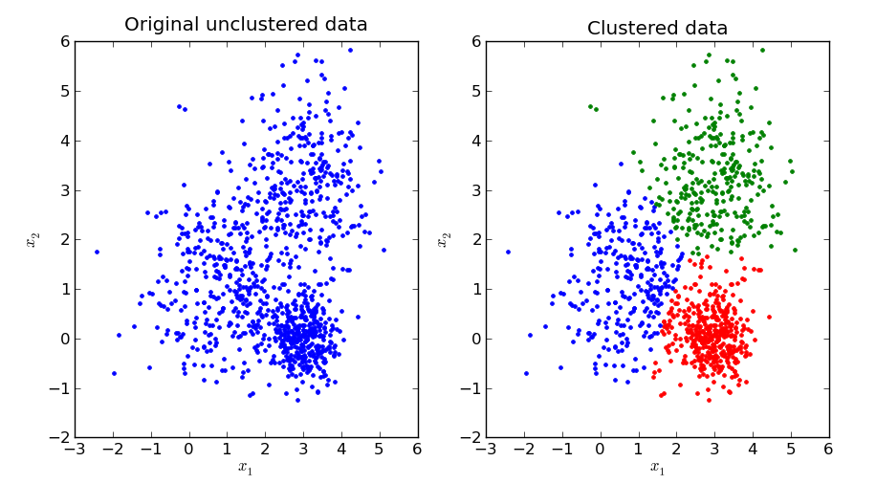
Any calculations that we choose

